Slide 1
An Introduction to Human-Aided Deep Learning
James K Baker, Bhiksha Raj, Rita Singh

Slide 2
Opportunities in Machine Learning
Great advances are being made in machine learning
After decades of intermittent progress, some applications are beginning to demonstrate human-level performance!
Artificial Intelligence
Machine
Learning
In the era of big data, there are many successful, valuable applications of machine learning
Deep Learning

Slide 3
Machine Learning is All Around You, Every Day
Machine Learning (From A. Ng, Coursera course)
Grew out of AI
New capabilities for computers
You probably use machine learning many times a day without even realizing it (Google search, product recommendations, advertising)
Examples:
Database mining
Large data from growth of automation/web
E.g. : Web click data, medical records, biology, engineering
Applications we can’t program by hand
E.g.: Autonomous vehicles, handwriting rec, speech rec, NLP, computer vision
Self-customizing programs
E.g.: Netflix, Amazon product recommendations
Understanding human learning
E.g.: Modeling the human brain, real AI
Deep learning – approaching or exceeding human performance

Slide 4
Opportunities in Machine Learning with Artificial Neural Networks
Great advances are being made in deep learning
Artificial neural networks are networks of simple representations of neurons.
The area of machine learning most associated with the opportunity of big data is deep learning based on artificial neural networks
Machine Learning using Artificial Neural Networks
Demonstrations of Super-Human Performance
Deep Learning
Accelerated progress repeatedly breaking records in performance benchmarks in many areas
Many layers of artificial neurons

Slide 5
Some of the Recent Successes of Deep Learning
Super-human performance reading street signs
Beating a top human player in the game of Go
Beating previous performance by training an image recognition network with over 100 layers
Human parity in recognizing conversational speech
End-to-end training of state-of-the-art question answering in natural language
Substantial improvement in naturalness of speech synthesis
Approaching the accuracy of average human translators on some datasets
Deep learning is beginning to meet the grand challenge of AI: Demonstrate human-level performance on tasks that require intelligence when done by humans.

Slide 6

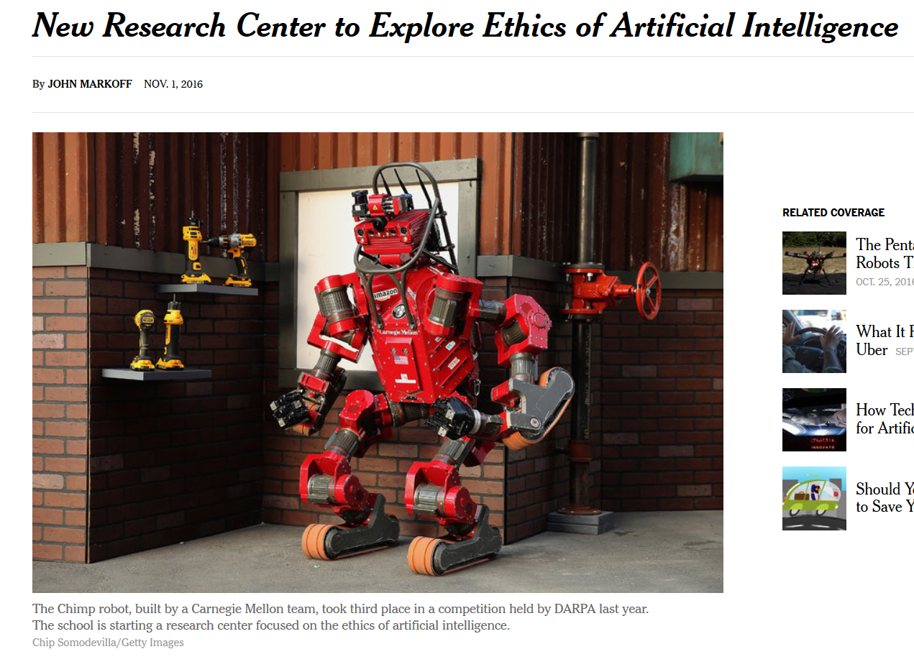
It is important to do it right!
CMU in the news
Deep learning raises particular issues because it is very difficult to interpret, much less control, what the millions of inner layer nodes represent or what they are doing.
More on this subject later.

Slide 7
Brief History of Pattern Recognition with Artificial Neural Networks
1950s Single neurons (Perceptron)
Adaptive learning
1960s Single layer of neurons
Stochastic gradient descent (perceptron convergence theorem)
Negative result: some things can never be learned with a single layer, no matter how big (e.g. millions in retina)
Multiple layers is a hard integer programming problem
Gap in progress …
… 1980s and later (continued on a later slide)
Rosenblatt, Principles of Neurodynamics
Minsky, Papert, Perceptrons: An Introduction to Computational Geometry

Slide 8
Why was there a gap in progress
Sometimes problems that seem very easy can actually be very hard
It seems easy to tell at a glance whether two regions are connected
Not connected
Connected
It is impossible to tell in general, even with an unlimited number of neurons!
Minsky, Papert, Perceptrons: An Introduction to Computational Geometry
It looks easy to tell if a region is connected.
Just glance at the figure on the next slide.

Slide 9
Just glance at this figure
Look here first
Don’t try to study the figure.

Slide 10
Was that one snake or two?
Are you sure?

Slide 11
One snake or two?
Were you sure?
Take more time.
Did your answer change?

Slide 12
One snake or two?
Did your answer change?
Did you get it right in the first diagram?

Slide 13
But that wasn’t the original diagram, this is
This example is in the spirit of the Minsky, Papert book, which was about computer vision. A much simpler example is that the Boolean function Xor cannot be represented with a single layer of perceptrons.
Do you still think you got the original problem correct?
One snake or two?

Slide 14
Brief History of Pattern Recognition with Artificial Neural Networks
1950s Single neurons (perceptron)
1960s Single layer of neurons
Gap in progress
1982: New interest (Hopfield network)
1986: Breakthrough: Error backpropagation algorithm
Allows an extra layer (a “hidden” layer between input and output)
Key insight: Use a differentiable threshold function (sometimes problems that seem hard are easy)
J. J. Hopfield, "Neural networks and physical systems with emergent collective computational abilities", Proceedings of the National Academy of Sciences of the USA, vol. 79 no. 8 pp. 2554–2558, April 1982.
Rumelhart, D., Hinton, G., Williams, R., Learning representations by back propagating errors, Nature vol. 323, 9 October 1986.

Slide 15
Brief History of Pattern Recognition with Artificial Neural Networks
1960s Single layer of neurons
1986: Backprop: One hidden layer
Many successes, but it was difficult to train more than one hidden layer
Other machine learning algorithms eventually beat benchmarks set by ANNs
1990s – 2006: Research continued, but progress slowed
2006: Breakthrough: Efficiently training multiple hidden layers
LeCun,Y.etal. Backpropagation Applied to Handwritten Zip Code Recognition, Neural Computation 1:(4)-541-551, 1989. (Convolutional neural networks)
Hochreiter, S. & Schmidhuber, J. Long short-term memory. Neural Comput. 9, 1735–1780
(1997). (Recurrent neural networks and LSTM)
LeCun, Buttou, et al, Effiicient Backpropagation, in Orr and Muller, Neural Networks: Tricks of the Trade, 1998 (Various tricks, including how to initialize the weights)
Hinton,G.E.,Osindero,S.&Teh,Y.-W.A fast learning algorithm for deep belief nets. Neural Comp. 18, 1527–1554 (2006).

Slide 16
Artificial Neural Networks 1986 - 2006
ANNs set several new pattern recognition benchmarks
Innovations continued (convolutional neural nets, recurrent networks, LSTM)
But, new methods (SVMs, random forests) began having higher performance than ANNs)
Although backpropagation can be done with multiple hidden layers, there was little success applying it (slow convergence, problems with local minima, overfitting)
Progress slowed, but didn’t stop

Slide 17
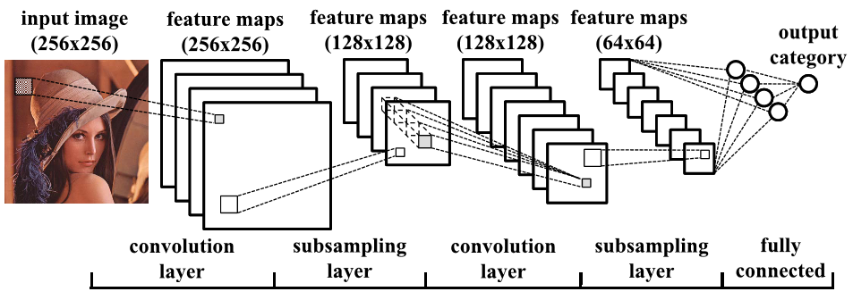
Architecture of Convolutional Neural Network
Suggested by processing in real eyes and brains.
Greatly reduces the amount of computation required
to train very large networks.
The same weights are used, shifted in position. Thus the output is the input convolved with the weights.
Because the weights are shared, there is more data per update estimate. Also, there is less memory required, so a larger network fits into RAM. There is also somewhat less computation.
The subsampling reduces both the number of nodes and the number of weights.

Slide 18
Fast Training for Deep Belief Nets - 2006
Game changing result: Launched the era of deep learning
Unsupervised training – one layer at a time
Unsupervised training allows one layer at a time
Requires special architecture
Top two layers form an undirected associative memory
Efficiently trained nets with many layers and millions of nodes
After unsupervised training of all layers, do an up-down pass of supervised training
Achieved 20 year goal of efficient multi-layer training for large networks
Hinton,G.E.,Osindero,S.&Teh,Y.-W.A fast learning algorithm for deep belief nets. Neural Comp. 18, 1527–1554 (2006).

Slide 19
Training Deep Learning Nets – 2006+
First, it turned out that the special architecture was not required
Other methods of unsupervised training to get the initial weights for multi-layered feedforward nets, followed by supervised training with backprop were also successful
Gradually, it became clear that even the initial unsupervised training was not essential, other fairly simple ways were found to get adequate initial weights
What did make the difference?
Large networks, very large amounts of data, very large amount of computation
1980-90s computers were not fast enough and did not have enough memory
LeCun, Buttou, et al, Efficient Backpropagation, in Orr and Muller, Neural Networks: Tricks of the Trade, 1998 (Various tricks, including how to initialize the weights)
Glorot, Bengio, Understanding the difficulty of training deep feedforward neural networks, AISTATS, 2010

Slide 20
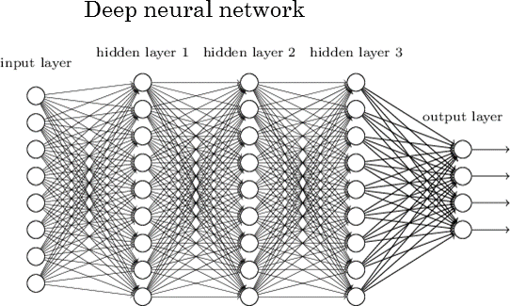
There is a (differentiable) function that measures the discrepancy of the actual output from the desired output.
Each arc has a weight w,
which is multiplied by its input.
Each node generates an output that is a differentiable function of the sum of its inputs.
Forward computation: The computation of the output of each layer of nodes proceeds from left to right.

Slide 21
Backpropagation: The computation of the derivative of the error function with respect to the weights proceeds backwards. (This is just the ordinary chain rule of elementary calculus.) Make an incremental update to each weight proportional to minus the derivative.
Rumelhart, D., Hinton, G., Williams, R., Learning representations by back propagating errors, Nature vol. 323, 9 October 1986.

Slide 22
Training a deep neural network
It is (almost) as easy as it looks (I have left out some details)
Just do the {feedforward, backprop, update weights} computation for each item of training data (an epoch), and then repeat epochs until convergence
But, it requires a lot of computation
Millions of nodes, billions weights, thousands of epochs, and as many data items per epoch as possible (sometimes millions)
Fortunately, it is easy to implement for parallel computation
Implementation on GPUs typically speeds up the computation by two orders of magnitude

Slide 23
Other Issues (with some solutions)
With the very large number of parameters, there is always a danger of overfitting the training data
Several things can reduce the amount of overfitting
One of the best is dropout; For each data item, randomly pick some of the nodes to “dropout” and not participate
Some large problems still require too much computation for general purpose networks (e.g. computer vision, speech recognition)
But they have a repetitive specialized structure: use convolutional neural nets
Some problems require learning sequences (number grows exponentially with length)
Use recurrent neural nets to track the sequences (with LSTM)
There are other issues which remain as problems; they will be discussed later
Vanishing gradient, overfitting, degradation with more layers, non-interpretablility, knowledge not explicit, non-use of domain-specific knowledge

Slide 24
Some of the Recent Successes of Deep Learning (Short List)
Super-human performance reading street signs
Beating a top human player in the game of Go
Beating previous performance by training an image recognition network with over 100 layers
Human parity in recognizing conversational speech
Substantial improvement in naturalness of speech synthesis
Distilling the knowledge of a large number of networks into a single network of the same size
Deep learning is beginning to meet the grand challenge of AI: Demonstrate human-level performance on tasks that require intelligence when done by humans.

Slide 25
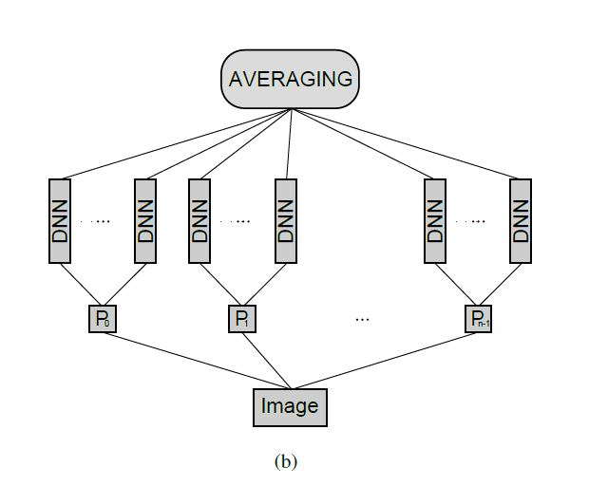
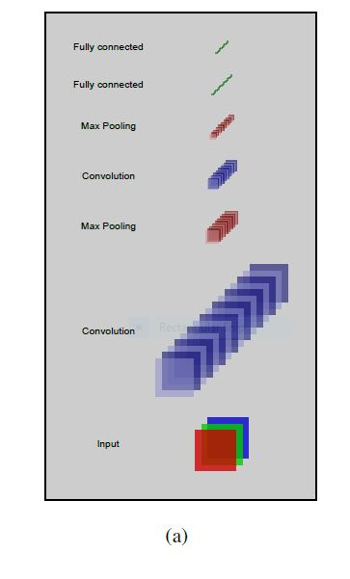
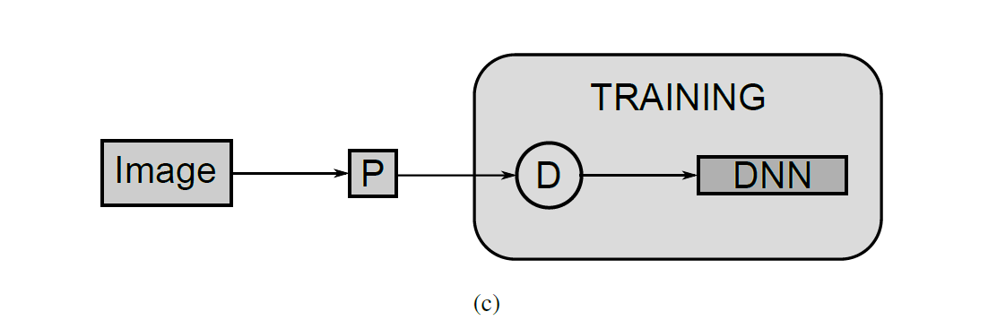
Multi-Column Architecture (On traffic signs, outperforms humans by factor of two)
Ciresan, Meier, Masci, Schmidhuber; Multi-column deep neural network for traffic sign classification; 2012.
One DNN from the Multi-Column
Averaging an ensemble
What’s new?
Multiple preprocessing methods and distortions; Averaging an ensemble.
Various forms of pre-processing and distortions

Slide 26
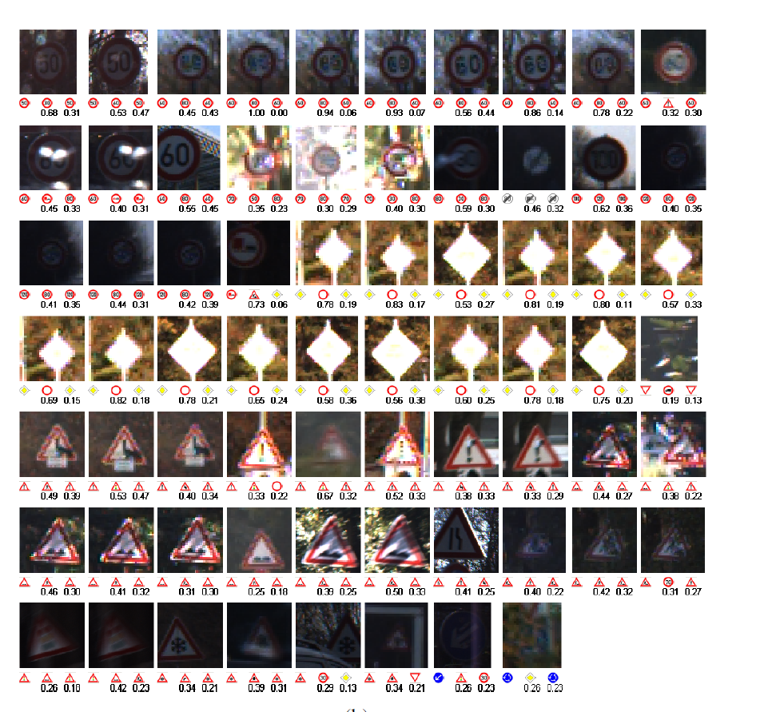
Traffic Signs Dataset
Ciresan, Meier, Masci, Schmidhuber; Multi-column deep neural network for traffic sign classification; 2012.
12569 images, only 68 errors
Human error rate
twice as high
Second best algorithm
3 times as many errors
Here are the 68 images it missed

Slide 27
Machine Learning and Games
Perfect information games (like checkers, chess, Othello, and Go) can be represented as a tree, with a node for each possible position and a branch for each possible move from that position
If the tree is too large for exhaustive search:
Define a policy function setting the probability distribution among the possible moves (cuts done on the effective number of branches at each node)
Define a value function to give an estimated value for each node when the search is terminated before end
Most successful game algorithms use Monte Carlo tree search (MCTS)
The computer plays games against itself and keeps a tree representing all games played
As more games are played, the value function becomes more accurate
The policy also improves by selected children with higher values
Further enhanced by policies that attempt to match human experts
Prior art: Shallow policies or value functions based on linear combination of input features

Slide 28
Alpha Go
Silver, Huang, et al, Hassabis, mastering the game of Go with deep neural networks and tree search, Nature VOL 529, 28 January 2016
Three deep neural networks: SL policy, RL policy, RL value
The architecture of each of the networks is a 2-d convolutional neural network based on the 19x19 grid of the Go board
Stage one: The SL policy network is trained to imitate the play of professional Go players, using supervised learning
Stage two (MCST): The algorithm plays games against itself and trains the RL policy and RL value networks using reinforcement learning
Probabilistic sampling of the search tree based on the value function.
Using deep learning to train the value function rather than simple linear combination of features.

Slide 29
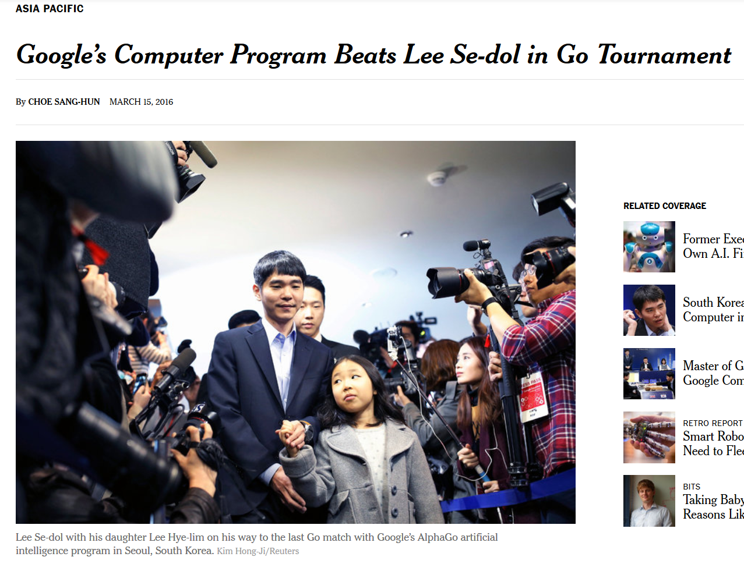
News about AlphaGo, (Silver, Huang, et al, Hassabis, mastering the game of Go with deep neural networks and tree search, Nature VOL 529, 28 January 2016)

Slide 30
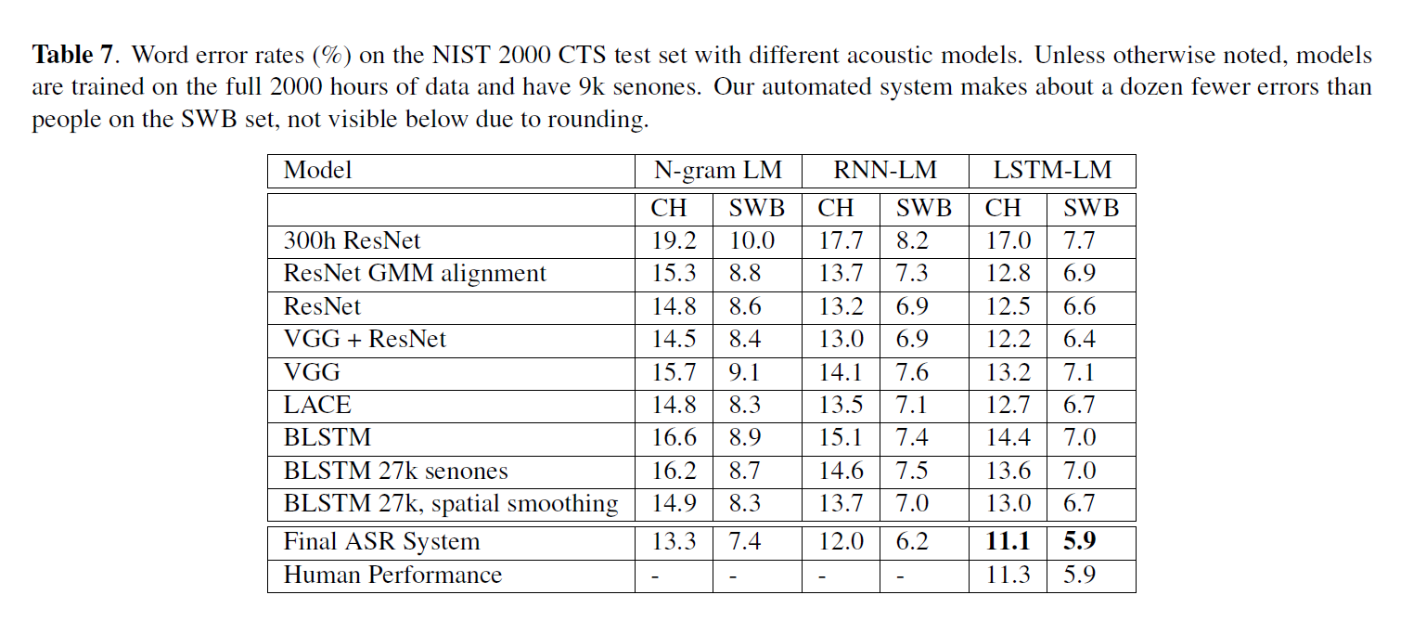
Milestone: Achieving Human Parity in Conversational Speech Recognition
Xiong, et al, Zweig, Achieving Human Parity in Conversational Speech Recognition, Microsoft Technical Report MSR-TR-2016-71
Each system is a carefully engineered combination of previously successful system components with a few innovations.
Ensemble performance
Matches human performance!
Conclusion: Ensembles win benchmarks

Slide 31
Can you get better learning just by adding more layers?
Problem: Vanishing gradient
After back propagating many layers, the gradient is close to 0
This problem was eventually solved (intermediate normalization layers)
Another problem: With additional layers, accuracy saturates and then rapidly degrades (Why?)
Not due to overfitting: performance on training data also degrades
(See a solution in next paper)

Slide 32
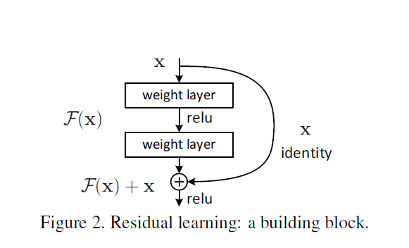
Deep Residual Learning for Image Recognition
https://arxiv.org/abs/.03385 (He, Zhang, Ren, Sun, Deep residual learning for image recognition, 2015; Building DNNs with many more layers; Winner of ISVRC & COCO 2015 competitions)

Slide 33
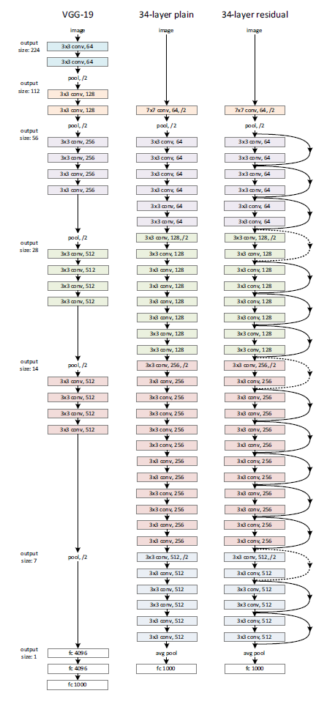
Deep Residual Learning for Image Recognition
https://arxiv.org/abs/.03385 (He, Zhang, Ren, Sun, Deep residual learning for image recognition, 2015; Building DNNs with many more layers; Winner of ISVRC & COCO 2015 competitions)
Deep residual learning allows so many layers that it is difficult to show them on a slide.
Comparison of three systems, each with many layers.

Slide 34
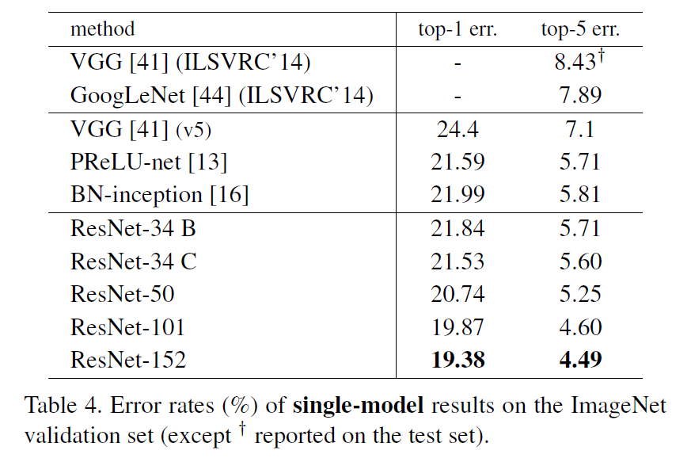
Deep Residual Learning for Image Recognition
Deep residual learning wins the 2015 competition.
Residual learning successfully trained 152 layers.
https://arxiv.org/abs/.03385 (He, Zhang, Ren, Sun, Deep residual learning for image recognition, 2015; Building DNNs with many more layers; Winner of ISVRC & COCO 2015 competitions)

Slide 35
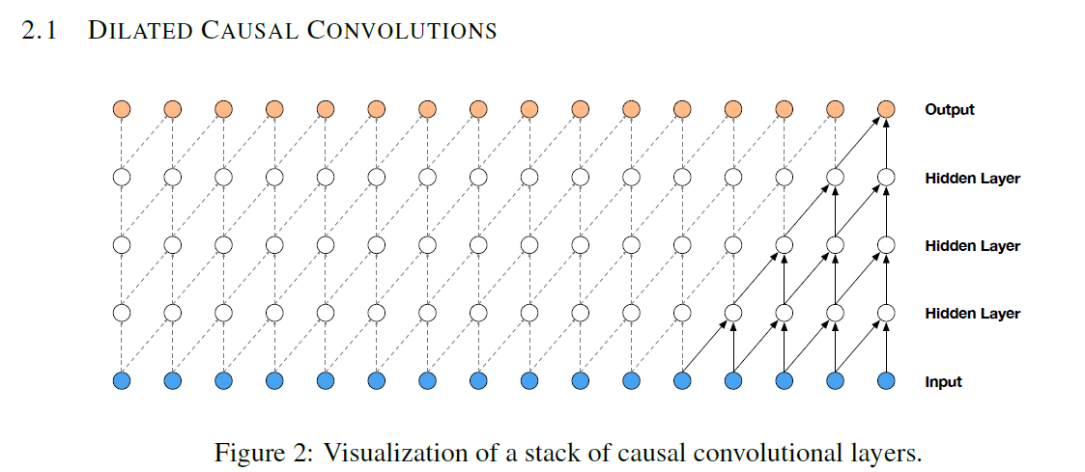
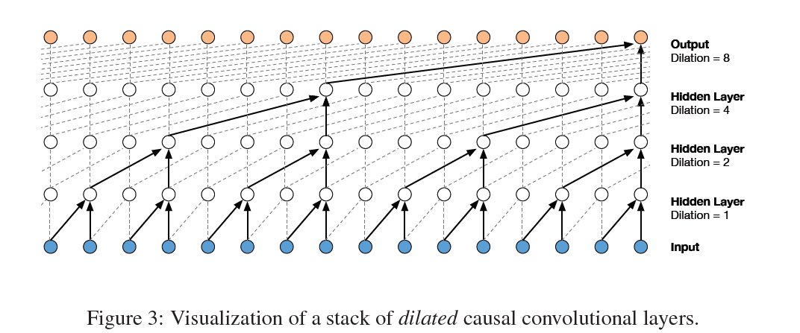
WaveNet: A Generative Model for Raw Audio
Causal convolution
Dilated causal convolution
https://regmedia.co.uk/2016/09/09/wavenet.pdf (van den Oord, et al, WaveNet: A Generative Model for Raw Audio, DeepMind, 2016)

Slide 36
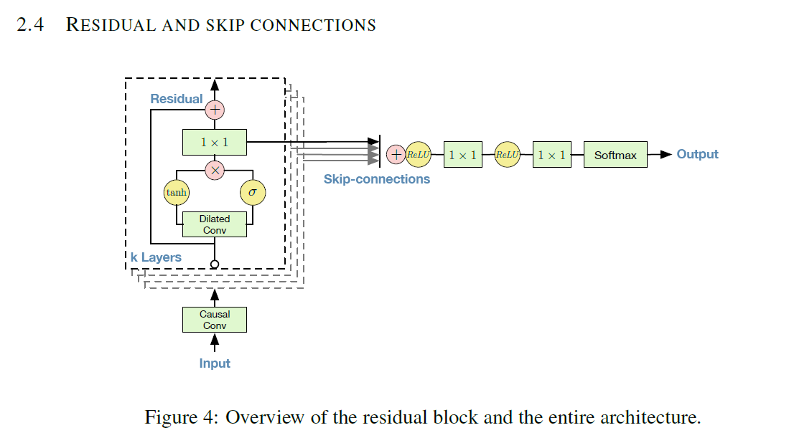
WaveNet: A Generative Model for Raw Audio
https://regmedia.co.uk/2016/09/09/wavenet.pdf (van den Oord, et al, WaveNet: A Generative Model for Raw Audio, DeepMind, 2016)
As before, residual learning allows a large number of layers.
With dilated causal convolution, using residual learning to enable training many layers, WaveNet is able to produce synthetic speech that sounds much more natural than any previous systems.
Dilated causal convolution and residual learning.

Slide 37
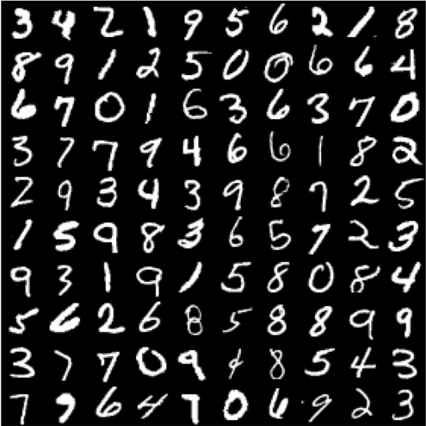
A Sample of Handwritten Digits (MNIST)

Slide 38
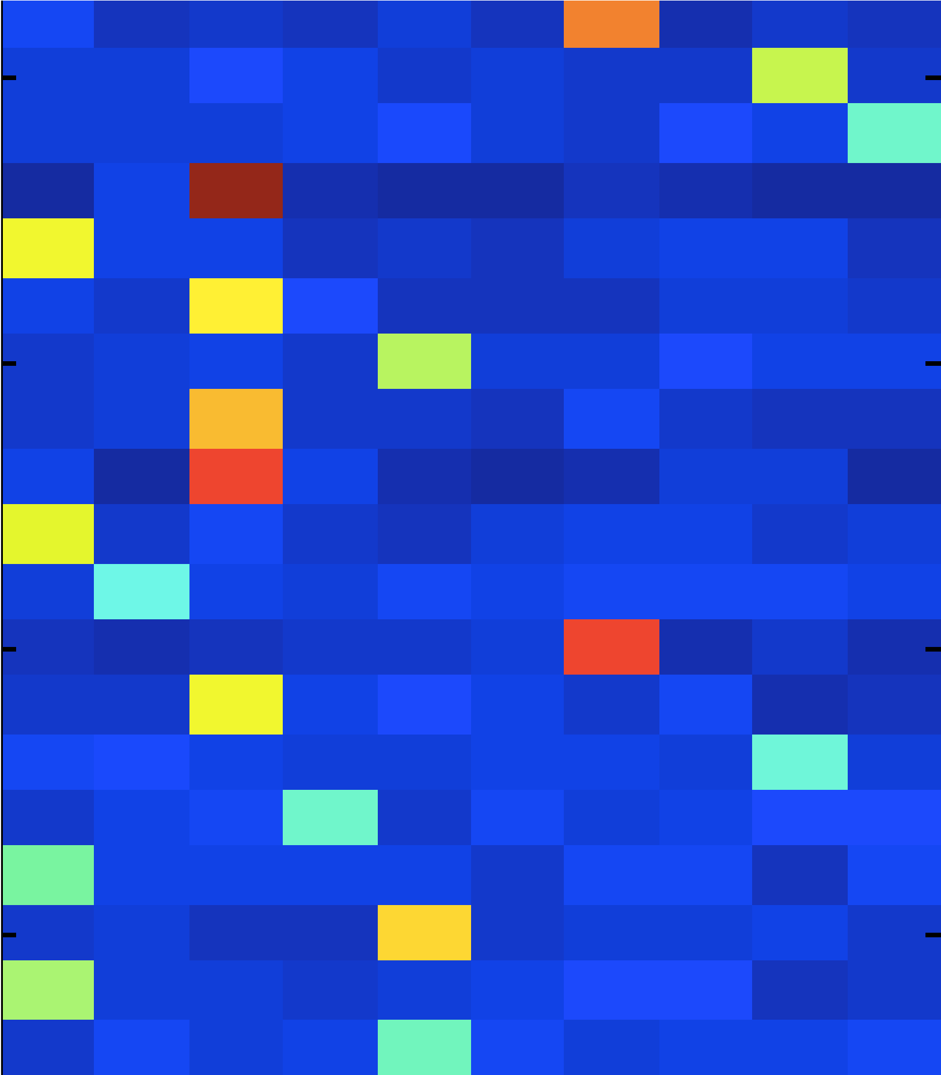



Soft Decisions (Hinton, 2015)
The “dark knowledge” is the knowledge available from the 2nd best and other scores. However, the scores need to be “softened” because the ensemble is too confident in the right answer.
The blue regions all look black with normal “hard” scoring. The extra knowledge is in these “dark” regions.
this 2 resembles a 1
and nothing much else
this 2 resembles
0
, 3, 7, 8
this 2 resembles
4
and 7
https://arxiv.org/abs/1503.02531 (Distilling the Knowledge of a Neural Network, Hinton, 2015, Uses MNIST as an example)

Slide 39
Distillation of Knowledge from an Ensemble to a Single Network
Train the ensemble
Average a soften version of the output of each member of the ensemble
Use this average as the objective for training a single network
Result: The single network is much closer to the performance of the ensemble than to the performance of a conventionally trained single network
Uses output of ensemble as supervision for a single network; Softens the output before averaging.
https://arxiv.org/abs/1503.02531 (Distilling the Knowledge of a Neural Network, Hinton, 2015, Uses MNIST as an example)

Slide 40
About the Course: An Introduction to Human-Aided Deep Learning
This is a reading and research course
That means that you will read state-of-the-art papers like those I have summarized and present them to your fellow students
We will begin with simpler papers providing background in the techniques
You will also have projects implementing these techniques
You will eventually implement a state-of-the-art benchmark (up to the capacity of our computing facility)
You will also have an opportunity to go beyond

Slide 41
Some Remaining Problems
Deep learning systems lack the wisdom of Socrates
“The only thing I know is that I don’t know anything.”
They are mysterious
It is difficult or impossible to know what the nodes and weights of inner layers represent
End-to-end training with no supplied expert knowledge is a major AI milestone
But it is also a major weakness and limitation
Ethical issue
How can we control systems if we don’t know what they are doing, and they don’t take advice or guidance?
Over confidence.
Non-transparency

Slide 42
The Missing Ingredient: Human Knowledge
Dilemma: How can we give advice or control deep neural nets if we can’t what the node activations and connections weights mean?
Idea: deep learning networks are good at learning many different things. Why not use a deep learning network to learn how to communicate with deep learning networks?
Introducing the concept of a Socratic coach: A Socratic coach is a second deep learning system associated with a primary deep learning system. However, rather than studying the primary data, the Socratic coach studies the primary deep learning system itself.
This concept changes the game.

Slide 43
How the Objective of the Game Changes
Being able to learn things on their own is one of the major achievements of deep learning systems. Does assistance from humans undercut that achievement?
In my opinion, if we can use machine learning to facilitate communication with end-to-end trained machines, we will have added to the achievement. The objective becomes the performance of the combined system.
The Socratic coach automates the task of a machine learning researcher. That is, it does a task requiring intelligence better than a human can do it.

Slide 44
How the Tactics of the Game Change
Using an outside expect, the Socratic coach, that acquires knowledge about the primary machine learning system greatly facilitates development of improvements in the primary system.
The Socratic coach learns to understand the primary system in ways that the primary system itself can’t even represent.
The Socratic coach can automate development testing, doing many more experiments than could be done by hand.

Slide 45
How the Game Changes for You
Everything that you learn about deep learning can be applied to designing and developing Socratic coaches, which can in turn be used to help develop better primary systems.
You will immediately be working at the cutting edge of new developments.
There may be an opportunity to put this to practice in a follow-on course or as an intern for a start-up.

Slide 46
Take Action
If you are excited about deep learning or about this opportunity to be at the cutting edge, please take the course 11-364: Introduction to Human-Aided Deep Learning
In any case, best wishes to you and thank you for your attention.

Slide 47
S-17 --11-364:An Introduction to Human-Aided Deep Learning and Socratic Coaches
You will read papers like those that I have discussed
You will present summaries of these papers to your peers
These papers are not be easy to read.
They assume a lot of prior knowledge from other papers.
You will implement at least one of the systems
You will replicate state-of-the-art results
Potential follow-on: Implementing ideas never tried before and/or interning with a start-up
This will be a challenging course, but you will learn a lot. I hope you will learn more than from any normal course. How much you learn will be up to you.

